Slide 1
Python for non-Python Developers
Christopher Harrison, SDE
Microsoft DX
@geektrainer

Slide 2
Setting expectations
About you
Already a developer
Looking at a project that involves Python
Django
Machine Learning
Automation
Have no Python experience
Just need to figure out the language piece before getting started
Not going to
…cover basic programming concepts
…cover everything
…make you an expert
…use any specific technology
…do any demos

Slide 3
What is Python?
Python is a widely used high-level, general-purpose, interpreted, dynamic programming language. (Wikipedia)
Open source
Flexible
Object oriented
Procedural
Functional
All sorts of uses
Common first language
Science & machine learning
Web development

Slide 4
Getting started

Slide 5
Installing Python
Two versions:
2.x (legacy)
Presently 2.7.12
3.x (current)
Presently 3.5.2
Which version to choose?
3.x whenever possible
Some older libraries may not have been ported
https://wiki.python.org/moin/Python2orPython3
Note for Windows developers
Make sure you select "add to path" when installing

Slide 6
Tooling
Any text editor will do
IDEs
PyDev (for Eclipse)
Spyder (Scientific PYthon Development EnviRonment)
PyCharm
Visual Studio Code (with Python extension)

Slide 7
Language basics

Slide 8
Python basics
Positional language
No curly braces { }
No end statements
Tabs or spaces
Technically doesn't matter
PEP 8 style guide states 4-space indentation
(PEP: Python Enhancement Proposal)
Casing
ClassName
function_name
variable_name

Slide 9
Variable declaration
No keyword to declare variable or type
Python determines type on the fly (weakly typed)
No constants
Convention to declare in ALL CAPS
Scope for modules, classes, functions and structure
Variables declared in an if block are scoped to there

Slide 10
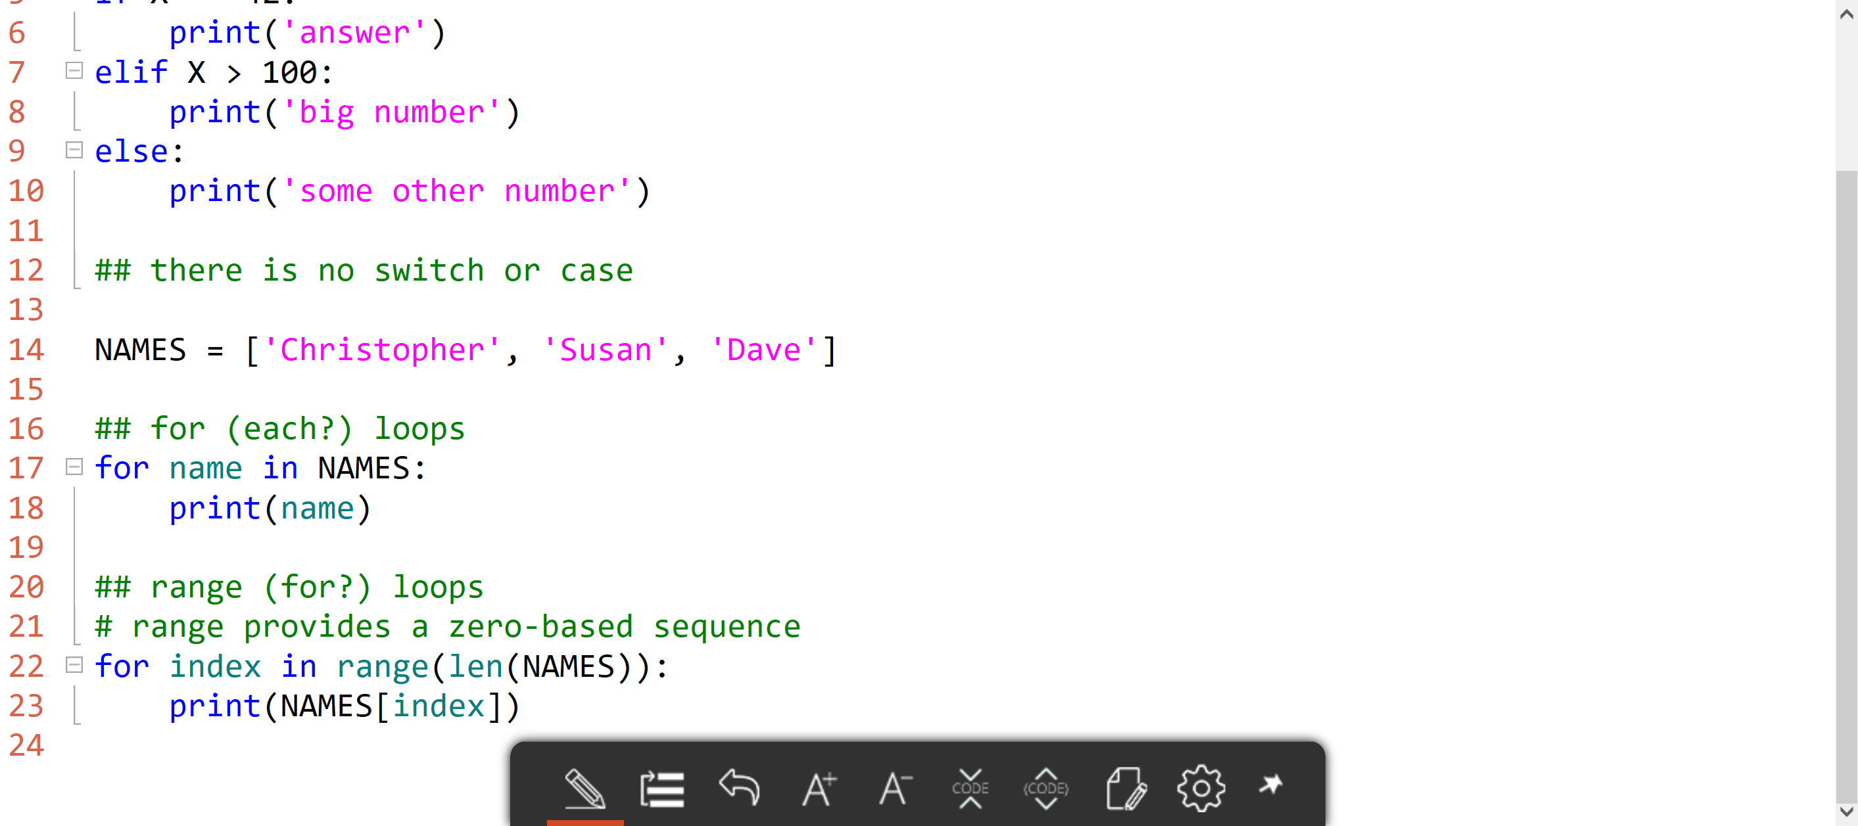
Logic

Slide 11
Other keywords
break
Stops the loop
continue
Continues the loop
pass
Does nothing
Used to ensure blocks are syntactically correct if they need to be empty
Swallow an exception

Slide 12
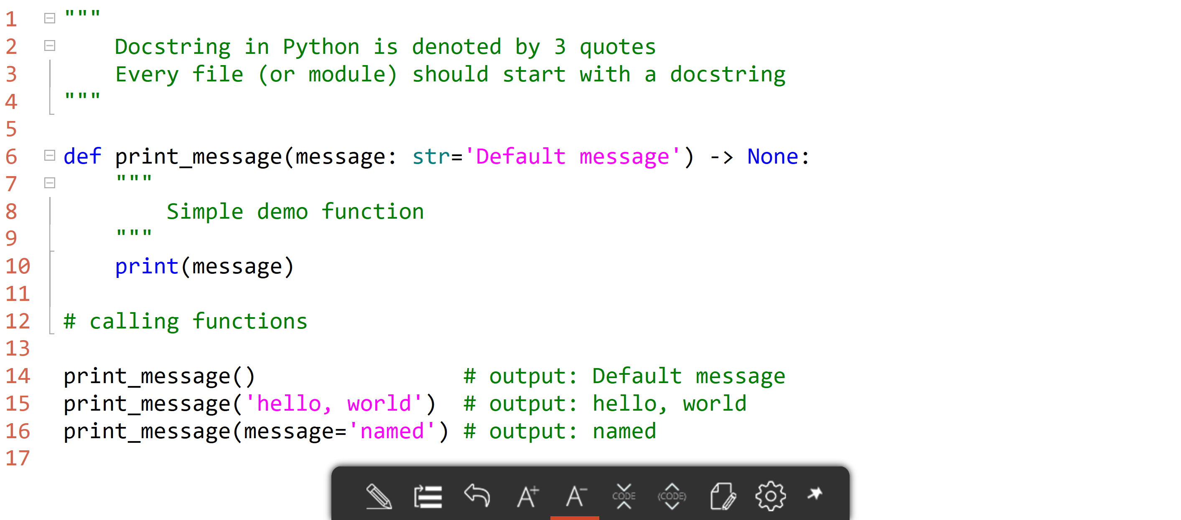
Functions and annotations

Slide 13
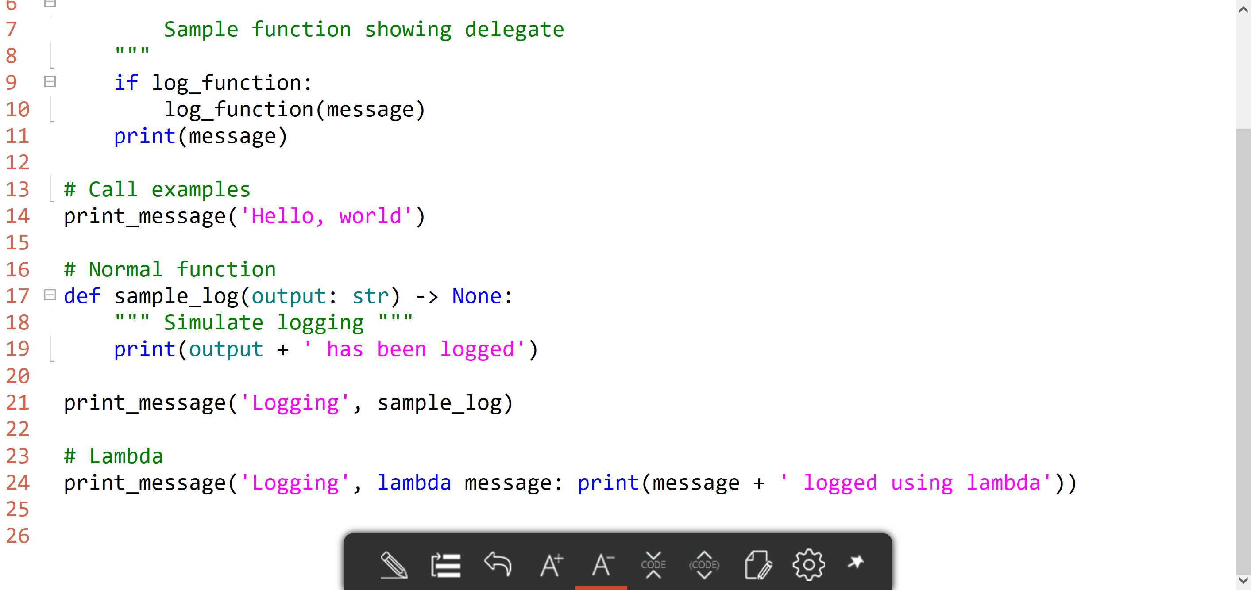
Lambdas (anonymous functions)

Slide 14
Hello, world

Slide 15
Exceptions
Python, like most languages, supports exception handling
Syntax is try / except / finally
Exceptions are named ___Error
FileNotFoundError
ValueError
Derive custom exceptions from Exception
Except blocks must be in order
Exception hierarchy
raise to throw/raise an exception

Slide 16
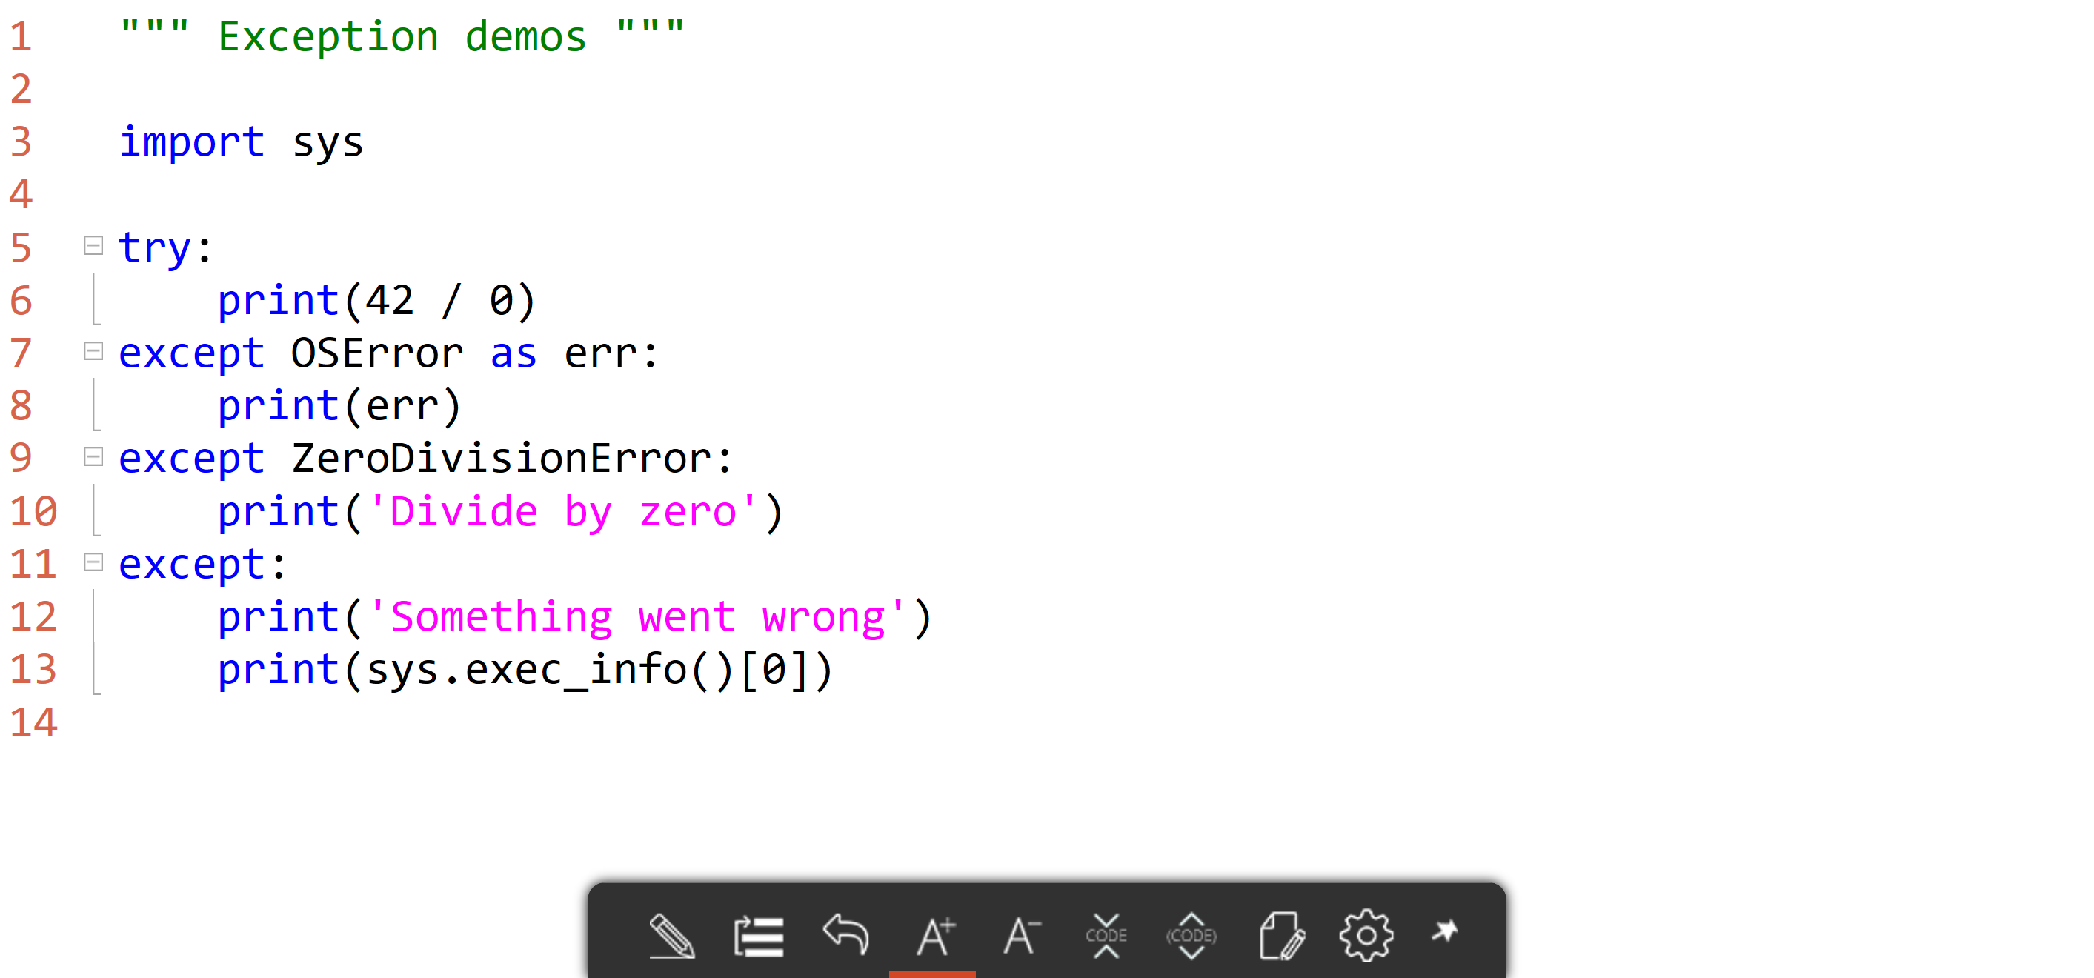
Exceptions

Slide 17
Exceptions

Slide 18
Creating classes

Slide 19
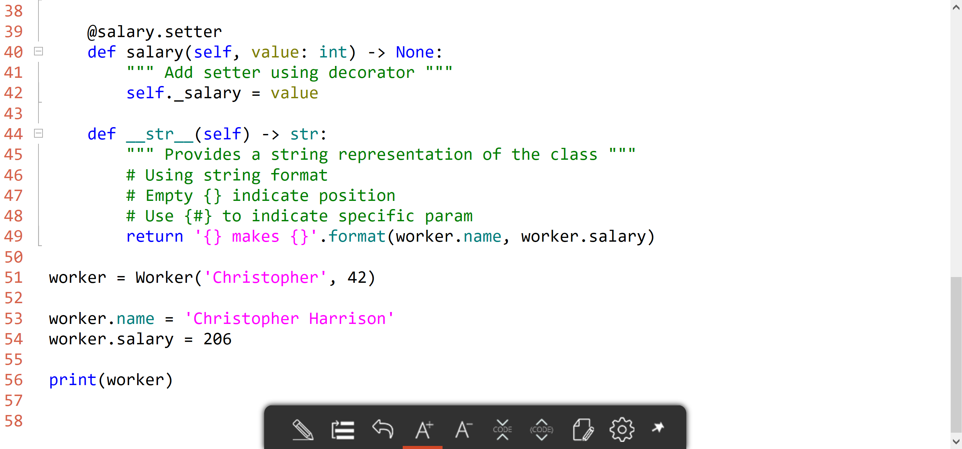
Python classes

Slide 20
Classes and properties

Slide 21
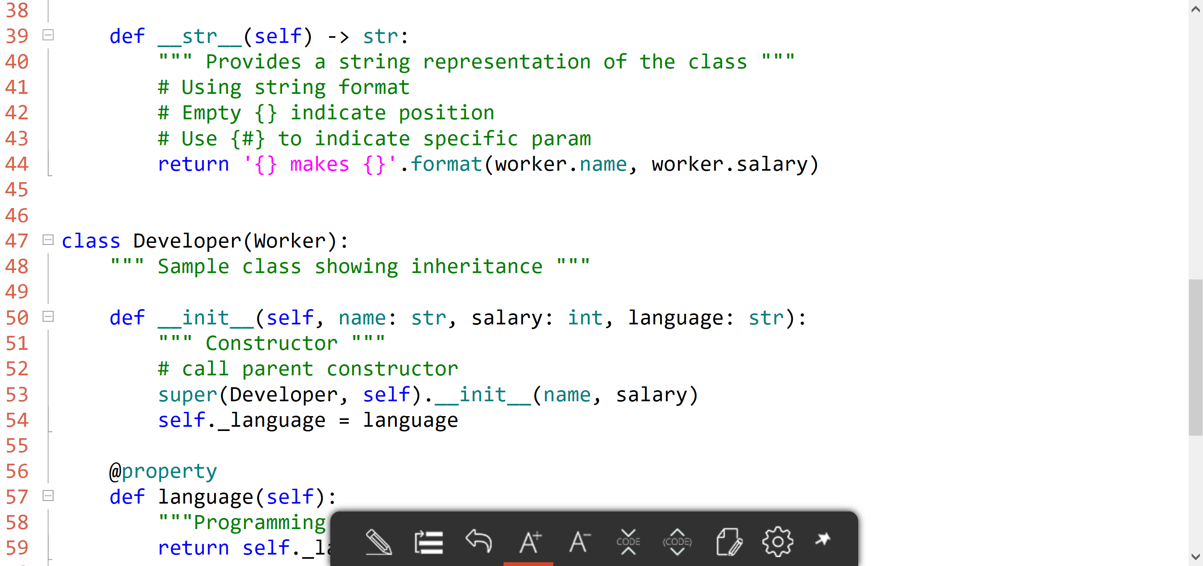
Inheritance

Slide 22
Python supports multiple inheritance
(deep breath... It will be ok...)
Multiple inheritance still isn't common
Or generally desirable
Most often used in frameworks

Slide 23
Inheritance

Slide 24
Package management with pip

Slide 25
Requirements file
## a comment
package-name # use latest
package-specific == 1.2.3 # only that version
package-exclusion != 1.2.3 # don't use that version
package-atleast >= 1.2.3 # at least that version
package-compatible ~= 1.2 # same as 1.*
-r other-file.txt # additional requirements file
https://somewhere/py.whl # install file

Slide 26
Command line
pip install package
Installs into current environment (or global)
pip install package==1.2.3
Supports same versioning syntax
pip install -r requirements.txt
Uses requirements.txt file
pip install --upgrade package
Upgrade a package
pip install --pre package
Include non-stable

Slide 27
Packages
Finding packages
PyPI Package Index
Python wiki
ActiveState
Must have support packages
autopep8
pylint

Slide 28
Virtual Environments
By default, packages are installed globally
virtualenv
Creates a separate folder
virtualenvwrapper
Simplifies working with virtual environments

Slide 29
Virtual environments

Slide 30
Creating modules and packages

Slide 31
Python modules
Simply files that contain
Functions
Classes
Code

Slide 32
Packages
Structured module namespaces
utils (folder)
__init__.py
datahelper.py
filehelper.py
datahelper would become available by using utils.datahelper

Slide 33
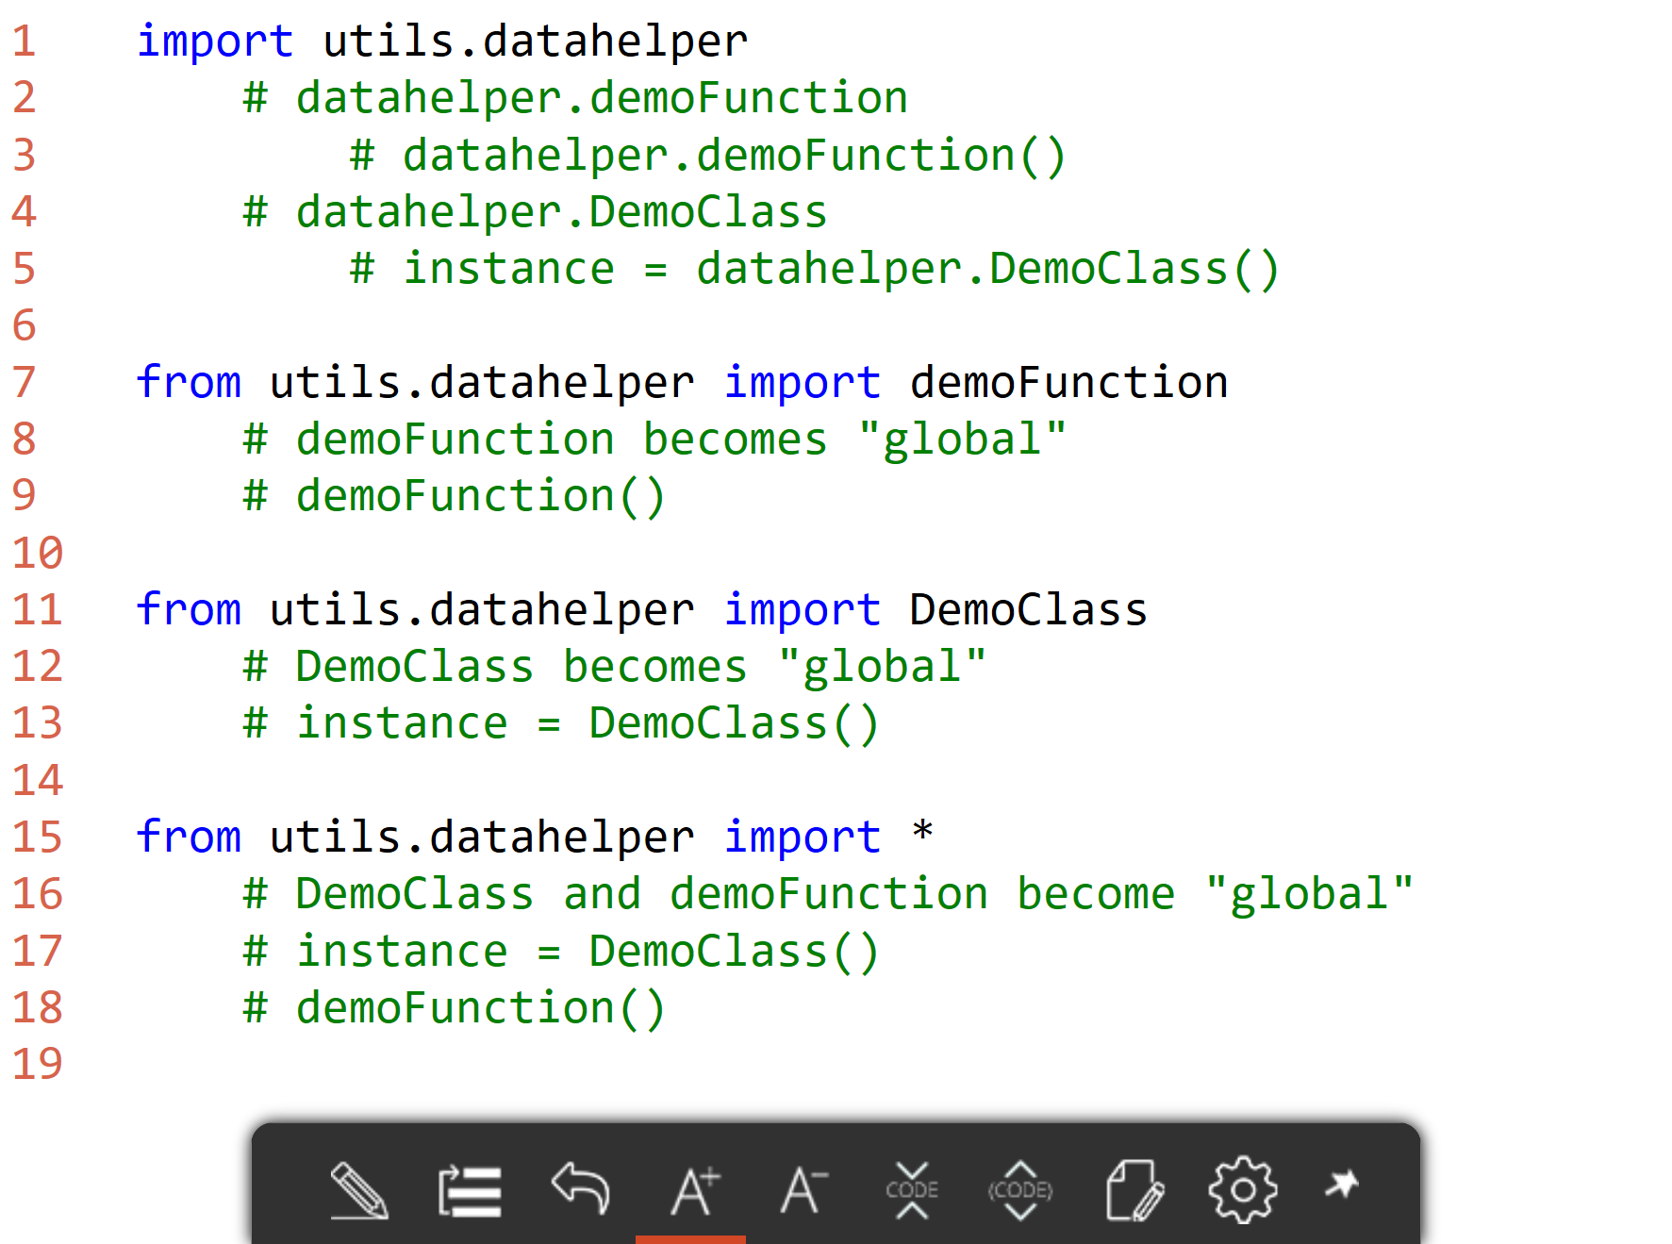
Importing modules
utils
__init__.py
datahelper.py
filehelper.py

Slide 34
Refactoring to packages

Slide 35
Python Standard Library

Slide 36
Python Standard Library
Modules to support common operations
Math
JSON
Networking
https://docs.python.org/3/library/index.html

Slide 37
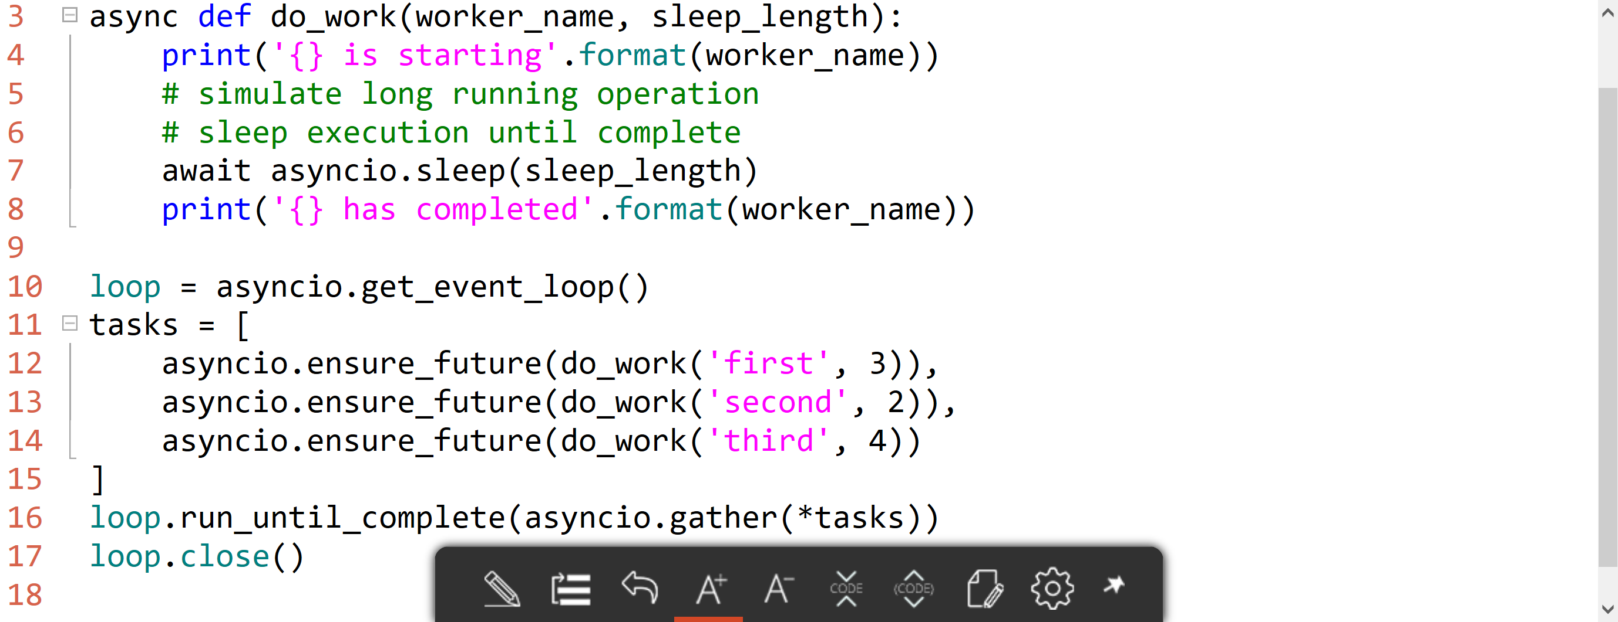
asyncio and Event Loop
asyncio is the core module for threading and async development
Event loop is the core object for managing threads and execution

Slide 38
Async and tasks

Slide 39
Simple unit testing with doctest
Write your tests into the docstring
"""
Sample function
Name must be at least two characters
>>> sample_function('a')
Traceback (most recent call last):
...
ValueError: Name must be at least two characters
"""
Run doctest.testmethod()

Slide 40
docstring and doctest

Slide 41
Resources
docs.python.org
The Hitchhiker's Guide to Python

